Slide 1
MGT 40750 – Quantitative Decision Modeling Spring 2017 Process Simulation
Professor Hong Guo

Slide 2
Process Simulation
Main Idea of Process Simulation:
Suppose you have a real world process whose efficiency you want to improve.
If there is uncertainty in this process (e.g., in the demand for a product, in the supply of some parts, in the time it takes to perform some of the work, in the quality of work, etc.), then it is often difficult to predict the effects of making various changes to the process.
With the technique called process simulation, you build a model of your process in a computer and then test the effects of changes made to this computer model.
If the model captures the essence of your real process, then this technique can help you decide which changes to make on the real process.

Slide 3
Examples of Process Simulation
Queuing systems
Logistics systems
Call centers
Computer networks
Manufacturing systems
Health care systems
Production scheduling
Conveyor systems
Inventory management

Slide 4
Basic steps in using process simulation
Draw a process flow map of the process.
Obtain data.
Input the model and data (typically in the form of statistical distributions) into computer.
Check that the computer simulation behaves like the real process (validation).
Perform experiments with the computer simulation by varying the values of variables of interest.
Analyze the results; look for combinations of the values of the variables that give the best performance.

Slide 5
Process Simulation – Waiting Lines
(SimQuick Chap 2)

Slide 6
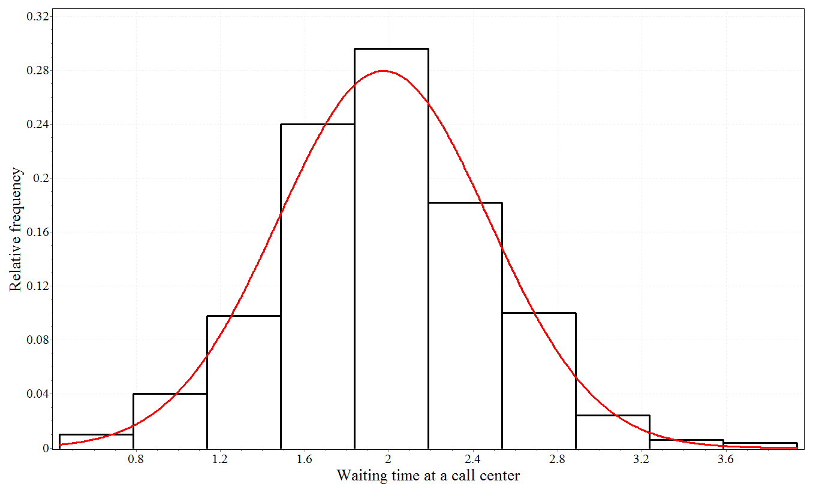
Review of Common Statistical Distributions
Normal Distribution: Nor(m,s) in SimQuick

Slide 7
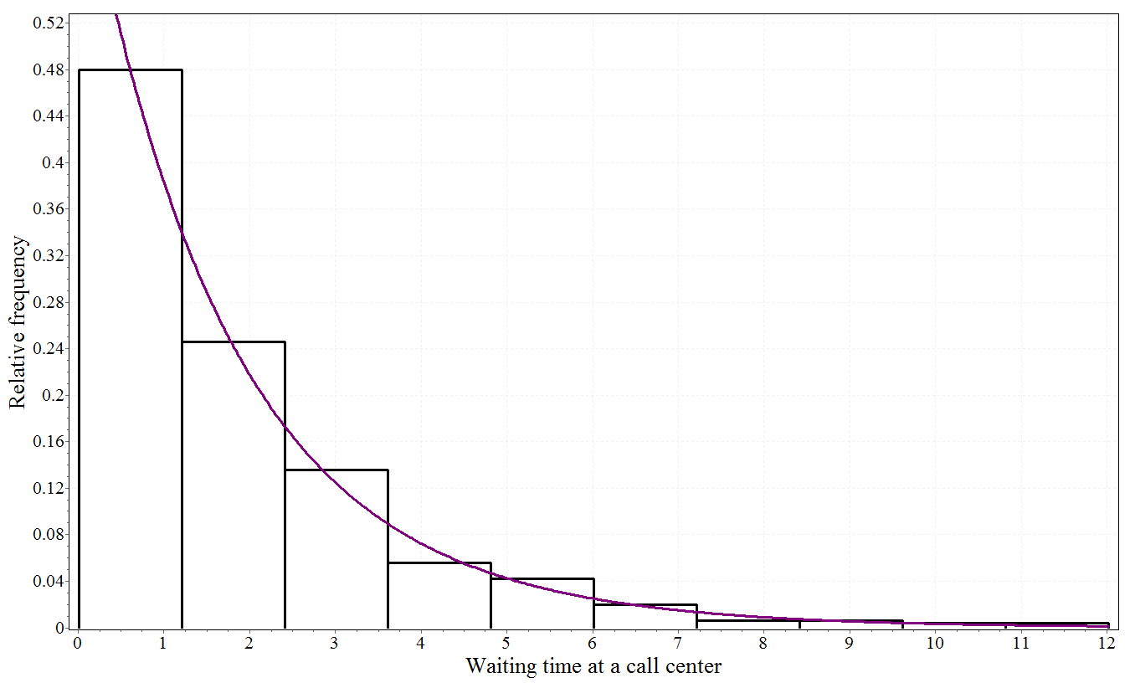
Review of Common Statistical Distributions
Exponential Distribution: Exp(m) in SimQuick

Slide 8
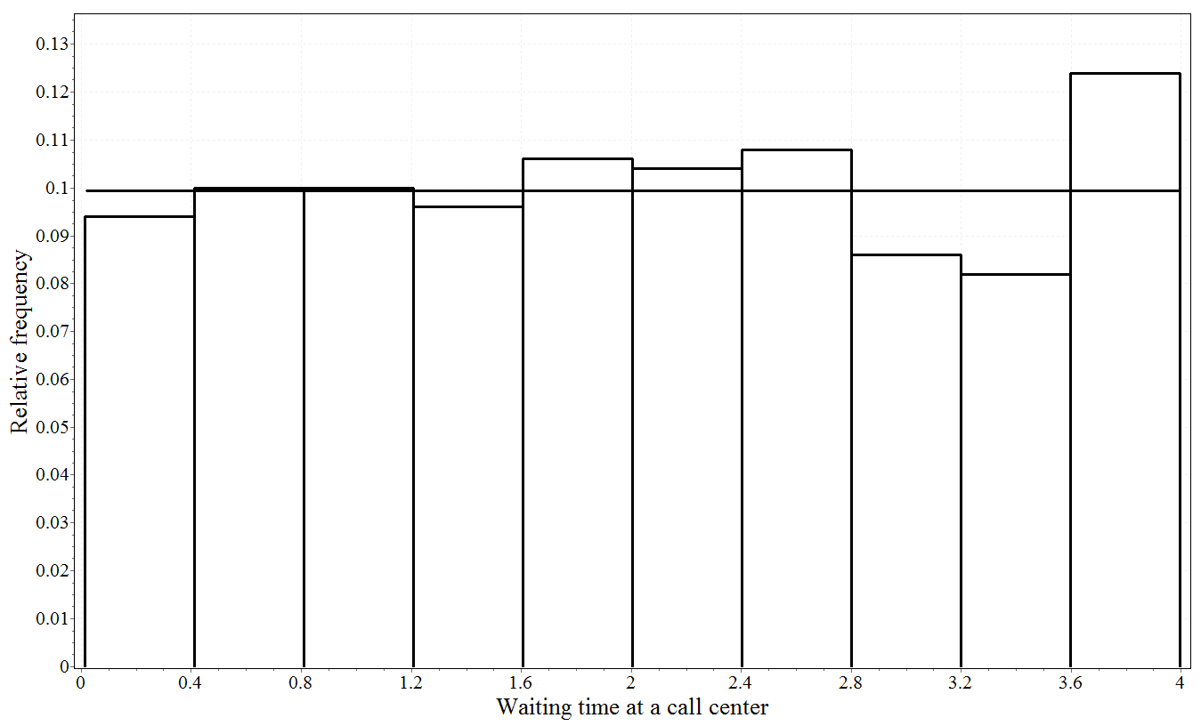
Review of Common Statistical Distributions
Uniform Distribution: Uni(a,b) in SimQuick

Slide 9
Example: A bank
Consider the following process within a small bank: customers enter the bank, get into a single line, are served by a teller, and finally leave the bank. Currently, this bank has one teller working from 9am to 11am.
Management is concerned that the wait in line seems to be too long. Therefore, they are considering two process improvement ideas:
Option 1: installing a new automated check-reading machine that can help the single teller serve customers more quickly
Option 2: adding an additional teller during these hours
What should management do?

Slide 10
Example: A bank
Process flow map:
Five Elements in SimQuick
Entrances, Exits, Work Stations, Buffers, Decision Points
Entrance
Door
Buffer
Line
Work Station
Teller
Buffer
Served Customers

Slide 11
Example: A bank
Question: What data to collect?
How long to serve a customer
How much time between customer arrivals
Capacity of line

Slide 12
Example: A bank
Some details based on data from the current process:
We have observed that the amount of time between arrivals of customers can be approximated by an exponential distribution with a mean of 2 minutes.
The line in this bank can only hold 8 people and if a person arrives when the line is full he/she does not get in line.
We have observed that the service time by the teller can be approximated by a normal distribution with a mean of 2.4 minutes and a standard deviation of .5 minutes.

Slide 13
Important Performance Measures for Processes
The service level for each simulation is the fraction of demand that is satisfied.
Service level for entrance = Objects entering process / (Objects entering process + Objects unable to enter)
For our example, in simulation #1:
Service level = 54 / (54 + 7) = .89
The overall mean service level of the process is the mean of the service levels calculated for each simulation; in this example it equals .88.

Slide 14
Important Performance Measures for Processes
The mean cycle time at a buffer is the mean amount of time an object takes to move through the buffer during a simulation.
For our example, in simulation #1:
Mean cycle time at Line = 10.64
The overall mean cycle time at a buffer is the mean of the mean cycle times of the buffer for each simulation.
In this example, the overall mean cycle time at Line = 10.59.

Slide 15
Option 1: Improving the system
We would like to analyze how would the performance of the bank be improved by the addition of a check-reading machine.
Suppose the addition of a check-reading machine would reduce service time per customer from Nor(2.4,.5) to Nor(2,.5).
How to change the original process simulation model?
Change working time for Teller to Nor(2,0.5)

Slide 16
Option 1: Process Improvement Results
Before the change,
Overall mean service level = 0.88.
Overall mean waiting time (i.e., overall mean cycle time at Line) = 10.59.
After adding a check-reading machine,
Overall mean service level = 0.98.
Overall mean waiting time = 5.48.

Slide 17
Option 2: Improving the system
How would the performance of the bank be improved by the addition of a second teller?
Process flow map for adding a second teller:
Work Station
Teller 1
Entrance
Door
Buffer
Line
Buffer
Served Customers
Work Station
Teller 2

Slide 18
Option 2: Process Improvement Results
Before the change,
Overall mean service level = 0.88.
Overall mean waiting time (i.e., overall mean cycle time at Line) = 10.59.
After adding a second teller,
Overall mean service level = 1.00.
Overall mean waiting time = 0.69.

Slide 19
Example: An airport security system
The passenger security process at one terminal of a medium sized airport works as follows:
Between 8am and 10am, one passenger arrives every half-minute (on average, according to an exponential distribution) at the security area.
Arriving passengers immediately enter a single line (with a large capacity).
After waiting in line, each passenger goes through one of two inspection stations, which involves walking through a metal detector and running any carry-on baggage through a scanner. The amount of time for this inspection can be approximated by a normal distribution with a mean of 1 minute and a standard deviation of .1 minutes.

Slide 20
Example: An airport security system
After completing this inspection, 10% of the passengers are randomly selected for an additional inspection, which typically involves a more thorough search of the person’s carry-on baggage.
There are two stations for this additional inspection; the amount of time for it can be approximated by a normal distribution with a mean of 5 minutes and a standard deviation of 1 minute.
We need a new element in SimQuick to model this system.
Decision Point

Slide 21
Process Flow Map: An airport security system
WS
Insp 1
Entrance
Arrivals
Buffer
Line 1
Decision Point
DP
WS
Insp 2
WS
Add Insp 1
Buffer
Line 2
WS
Add Insp 2
Buffer
Done

Slide 22
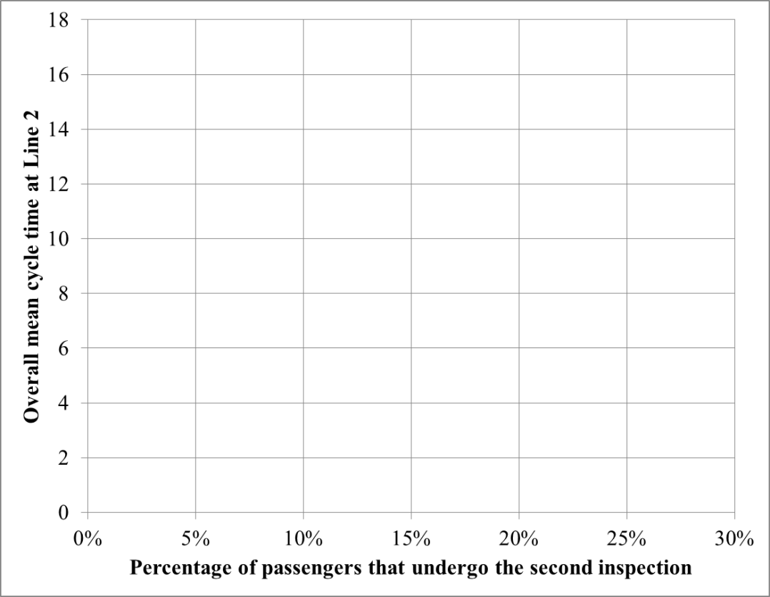
Sensitivity Analysis
The key statistics for airport management are the passenger waiting times. Management is interested in examining the effect on waiting time of increasing the percentage of passengers that undergo the second inspection.
Record the overall mean cycle time at Line 2 with varying percentages of 5%, 10%, 15%, 20%, 25%.

Slide 23
Process Simulation – Inventory
(SimQuick Chap 3)

Slide 24
Example: A Grocery Store (an “order-up-to” policy)
Management at a grocery store has received some complaints from customers that the store occasionally runs out of SuperWheat bread, which is baked by the SuperBread Company. Here is how the inventory process presently works.
A truck from the SuperBread bakery drops off several types of loaves of freshly baked bread at the grocery store every other day.
For each type of bread from the bakery, there is designated space on the shelves of the store and in the back of the store (the total space allotted to each type of bread depends on the demand for that type of bread).
The driver drops off enough loaves for each type so the designated space for each type of bread is filled. (This is a simple version of what is sometimes referred to as an order-up-to inventory policy.)
The store has designated enough space to hold 70 loaves of SuperWheat bread.

Slide 25
Example: A Grocery Store (an “order-up-to” policy)
An examination of sales records (at times when there is SuperWheat on the shelf) shows that the time between purchases of a loaf of SuperWheat is .3 hours on average (with an exponential distribution).
Management estimates that this demand pattern should be the same for the next 30 working days.
The store is open 12 hours per day, 7 days per week.
Management wants to determine the amount of storage space that should be designated for SuperWheat bread so that 99% of the customer demand is satisfied.
We need a new element in SimQuick to model this system.
Exit

Slide 26
Process Flow Map: A Grocery Store
Entrance
Loading Dock
Buffer
Storage
Exit
Purchase Requests

Slide 27
Process Simulation – Manufacturing
(SimQuick Chap 4)

Slide 28
Two Key Performance Measures of Manufacturing Processes
Throughput of a process: number of good units produced during some time period (we assume plenty of raw materials, so this may also be interpreted as “capacity”)
Cycle time of a process: The mean amount of time it takes one unit to go from the start to the finish of a process.

Slide 29
A Production Game
Draw the process flow map.
Set up SimQuick to simulate the production game.
Estimate working time of WSs using Uni(a,b)
Buffer
Raw Materials
WS
WC1
WS
WC5
Buffer
Finished Goods
…

Slide 30
A Production Game
What is the overall mean throughput?
Final inventory of Finished Goods
What is the overall mean cycle time of the process?
Add all potential delays together including working times of work stations, cycle times of internal buffers of work stations, and cycle times of buffers.
What is the utilization of a work station?
Fraction time working of the work station

Slide 31
How to improve the throughput of the process?
One easy solution is to add buffers – work-in-process (WIP) inventory

Slide 32
Concepts involved in manufacturing processes
Throughput of a process:
Number of good units produced during some time period
Cycle time of a process
The mean amount of time it takes one unit to go from the start to the finish of a process.
Work-in-process (WIP) Inventory
Utilization of a work station
Causes of variability in a manufacturing process:
Processing times of machines/workers
Quality of output of machines/workers
Demand of customers (at end of process; i.e., the last “machine”)
Reliability of suppliers (at beginning of process; i.e., the first “machine”)

Slide 33
Principles from the production game (relationships between the concepts)
As work-in-process inventory increases (from near zero):
Inventory costs increase.
Throughput of process increases (to a point, after which it remains the same).
Cycle time of process increases.
As variability decreases, throughput of process increases.

Slide 34
Demo of graphical simulation packages
AnyLogic
www.anylogic.com
Simulation Visualization
https://www.runthemodel.com

